Slide 1
Real-Time Motion Planning Approach for Automated Driving in Urban Environments
Atakan Salih Bolat

Slide 2
Outline
Contribution of paper to literature
Real time planning
Path planning approach
Collision checking
Speed profile generation
Trajectory generation
Conclusion

Slide 3
Contribution of paper to literature
Balanced between optimality and computing time
Determinism at medium and high speeds
Considering kinodynamic constraints of vehicle
Avoiding static and dynamic obstacles

Slide 4
Real time planning
Computation of optimal path at medium and high speeds
Avoiding dynamical obstacles

Slide 5
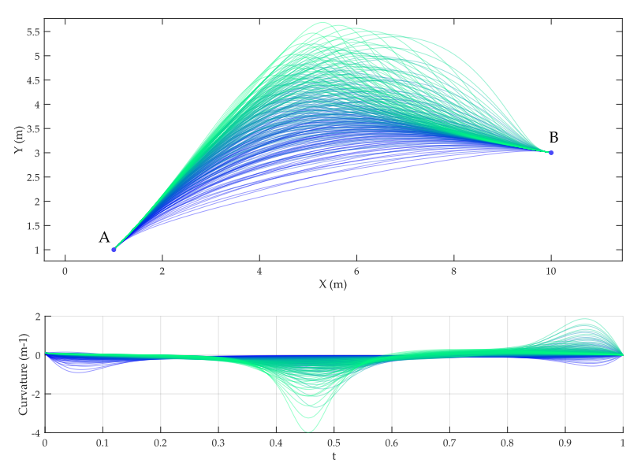
Path planning approach
Continuous curvature path
High degree of quintic Beziér curves provide high controllability at the extreme points (degree of freedom to adjust velocity and acceleration)
Figure 1.
Top: Quintic Bézier Curves
Bottom: Curvature of each curve

Slide 6
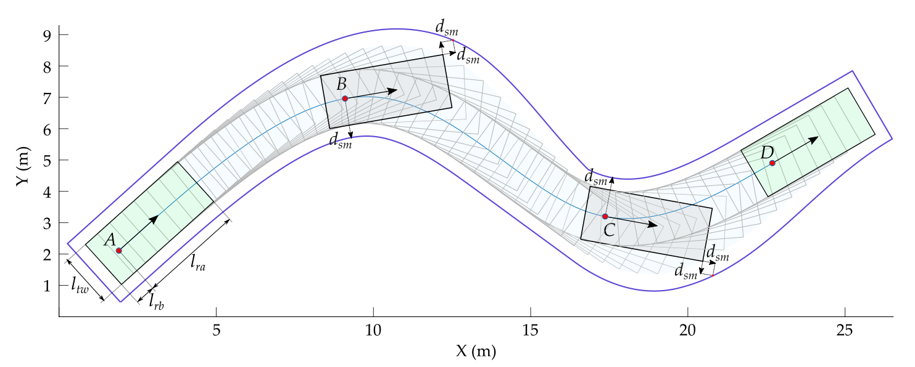
Collision checking
Most expensive process
Calculate collision check with approximate bounding rectangle with added safe margin
Figure 2. Occupancy map of a regular vehicle

Slide 7
Speed profile generation
Limits longitudinal and lateral acceleration as well as speed
Initial speed and final speed are calculated

Slide 8
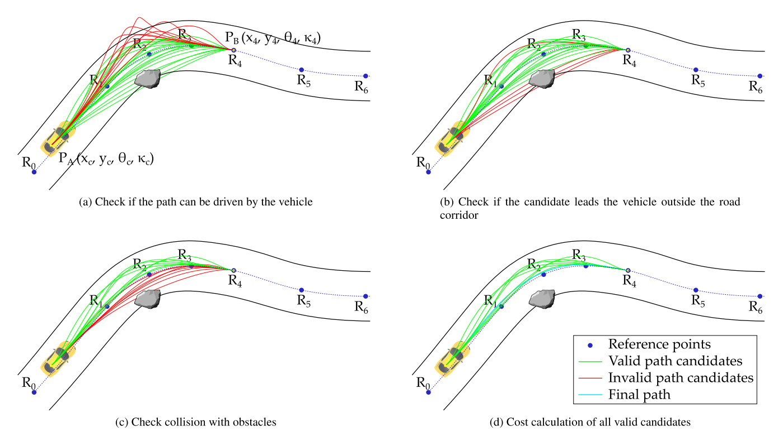
Trajectory generation
Problem initialization
Candidates evaluation
Best candidate selection and final trajectory calculation
Figure 3. Path candidates and their evaluation

Slide 9
Conclusion
Optimality between convergence and computation time
Path and speed profile generation
Real time operation

